Slide 1
GAME THEORY
By Giuseppe Scalora
HSHL – 6th Semester
ELE – 07.07.2021

Slide 2

Motivation
https://rapidecology.com/2018/05/09/the-game-theory-of-scooping-grad-students/

Slide 3
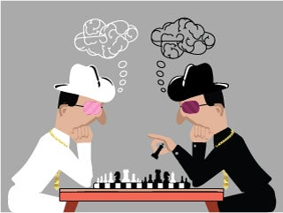
What is Game Theory?
Game theory is defined as the science of strategy, or the optimal decision-making of independent and competing actors, typically called “players”, in a strategic setting called “game”.
https://ocw.mit.edu/courses/economics/14-126-game-theory-spring-2016/

Slide 4
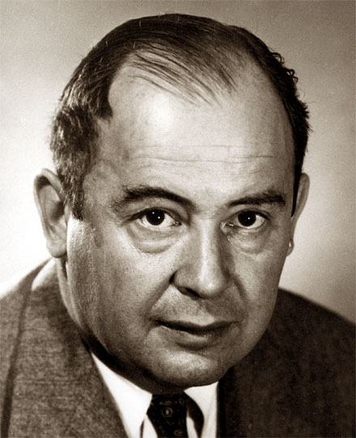

A little bit of background...
^{John Von Neumann, 1903 – 1957}
https://biografieonline.it/biografia-john-von-neumann
^{John Nash, 1928 – 2015}
https://biografieonline.it/biografia-john-nash

Slide 5
Fields of application
Mathematics
Economics
Sports
Biology
Computer science
Psychology
Philosophy
And many others...

Slide 6
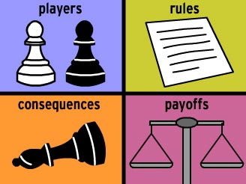
Types of games
Cooperative/Non-cooperative.
Zero sum/Non zero sum.
Simultaneous and sequential.
https://psychgames.weebly.com/game-theory.html

Slide 7
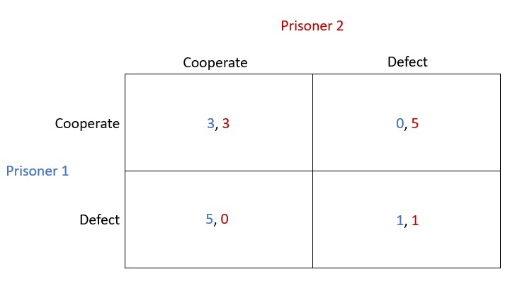
Prisoner´s dilemma
https://blog.methodsconsultants.com/posts/the-prisoners-dilemma/

Slide 8
Nash Equilibrium & Stackelberg
Each player is assumed to know the equilibrium strategies of the other players and no player has anything to gain by changing only their own strategy
A strategic game in which at least one player is defined as the leader who can make a decision and commit a strategy before other players who are defined as followers.

Slide 9
Game theory on HLS
Validation and verification of hardware design using game theory.

Slide 10
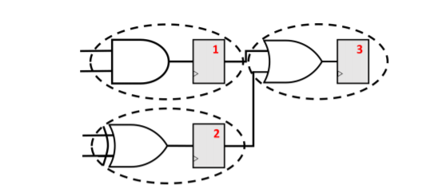
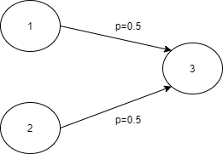
Goal and approach
The main goal of the research is to develop a security procedure to protect hardware design from malicious attacks. A proposed approach aims to protect the design part of the hardware system, at logic gates level.
Smith, Andrew, Mayo, Jackson, Kammler, Vivian, Armstrong, Robert, Vorobeychik, Yevgeniy. (2017). Using computational game theory to guide verification and security in hardware designs. 110-115.

Slide 11
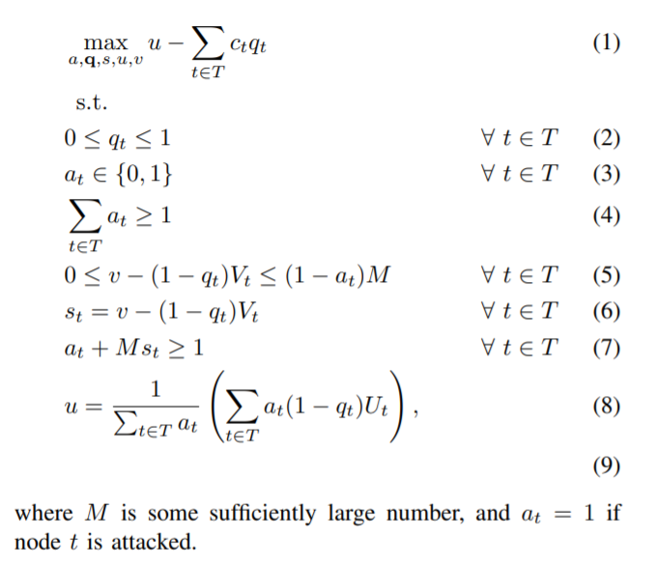
Stackelberg
Security games applied

Slide 12
Conclusions: Key elements
Background
Fields of application
Variety of games
Main application on HLS

Slide 13
Thank you all for your attention!
If you have any question, feel free to ask!

Slide 14
References
https://github.com/GiuseppeScalora/Game-Theoretic-Algorithm
Camerer, C., 2003. Behavioral game theory. New York :s: Russell Sage Foundation.
Osborne, M., 2012. An introduction to game theory. New York: Oxford University Press.
Webb, J., 2007. Game theory. London: Springer.
Smith, Andrew, Mayo, Jackson, Kammler, Vivian, Armstrong, Robert, Vorobeychik, Yevgeniy. (2017). Using computational game theory to guide verification and security in hardware designs. 110-115.

